Slide 1
PCB Design Defence
Chin Ming Ryan Wong

Slide 2
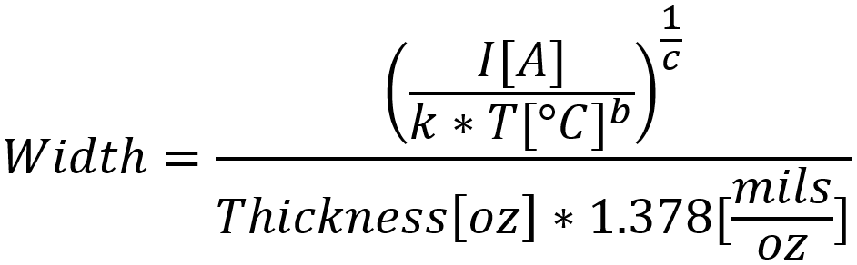
Trace Width Guideline
Goal: Show how trace width is calculated using the formula shown in equation 1.
Equation sourced from 4pcb.com board house
Constants k, b, c, follows Generic Standard on PCB
IPC-2221 (Generic Standard on PCB) constants:
k = 0.024
b = 0.44
c = 0.725
Constants derived from IPC-2221 curves
Only use trace width formula as a guideline, trace width must be greater than formula
Conclusion: Trace width formula cannot be verified but is suggested by board house.
Trace width formula

Slide 3
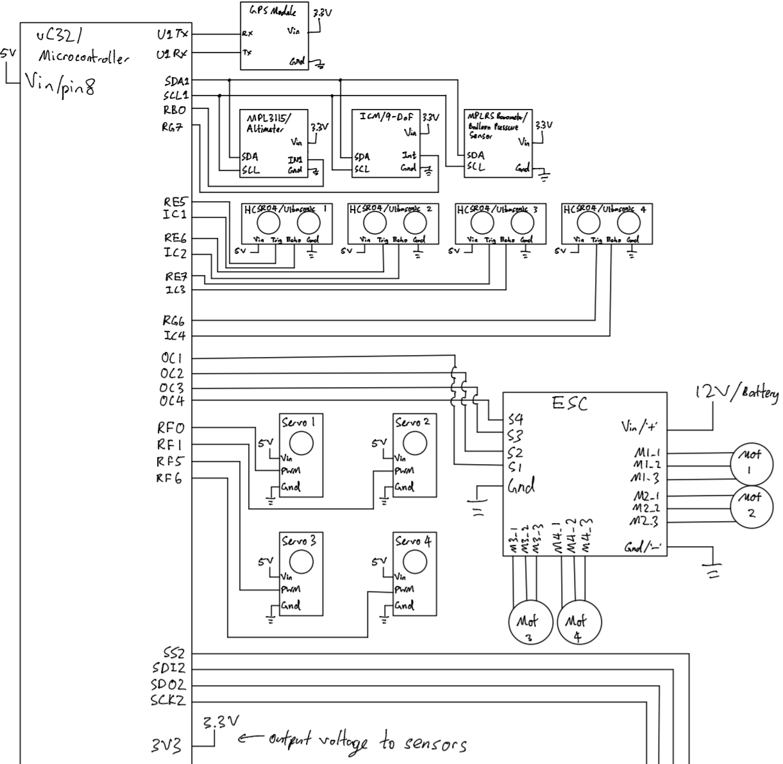
Development Board Schematic
Current Implementation of microcontroller and sensor array uses development board.
PIC32 microcontroller receives RC controls and outputs PWM signal to 4 servos and 4 motors.

Slide 4
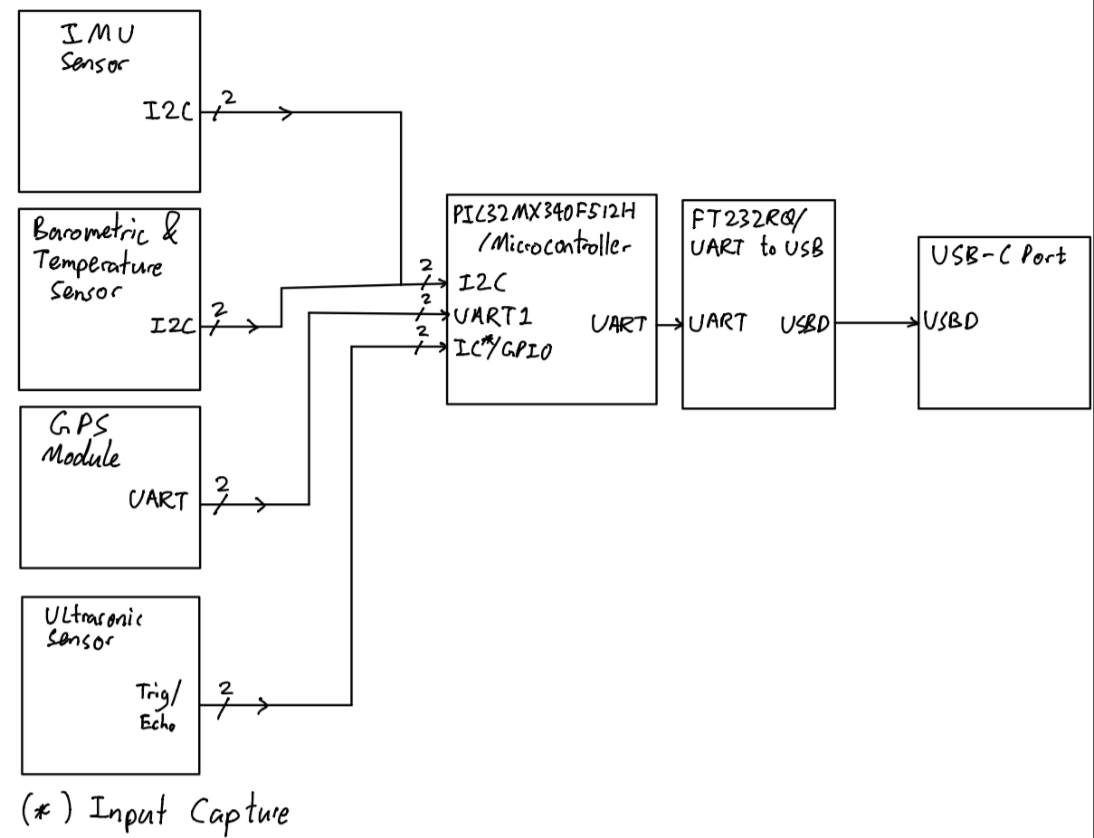
PCB Sensor Array Verification Method
System Requirement: Manufacturability
Expectation: Sensor array data should be able to be displayed to a computer monitor
Procedure:
Plug in The USB-C header to a PC
Plug in the 12V lipo battery to the PCB
Open the PuTTY terminal
Set the PCB on the table
Verify GPS longitude data matches to Google maps location
Verify barometric sensor matches to 1atm at sea level
Verify the IMU accelerometer data matches 9.8m/s^2 in one axis and the rest are 0m/s^2
Move a flat surface towards the ultrasonic sensor and verify the distance with a ruler
Block diagram for sensor array debugging
Notes:
Sensor Array Debugging (altimeter, IMU, GPS, barometric sensor)
Debug via UART from PIC32 microcontroller to FT232 UART to USB Protocol using PuTTY
Second UART pins from PIC32 allocated for sensor data printouts

Slide 5
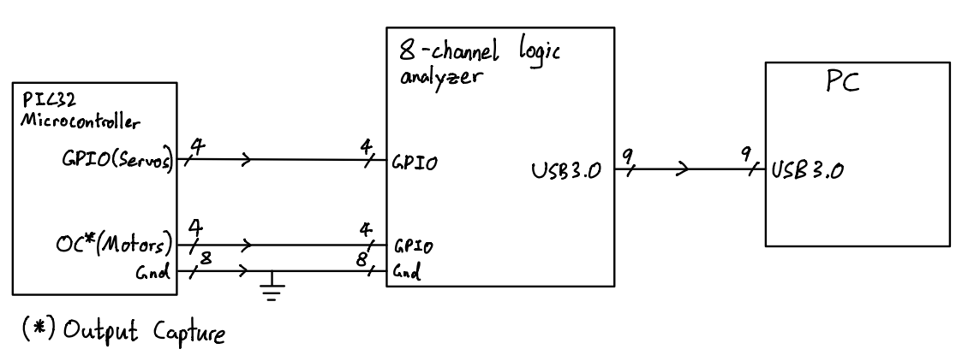
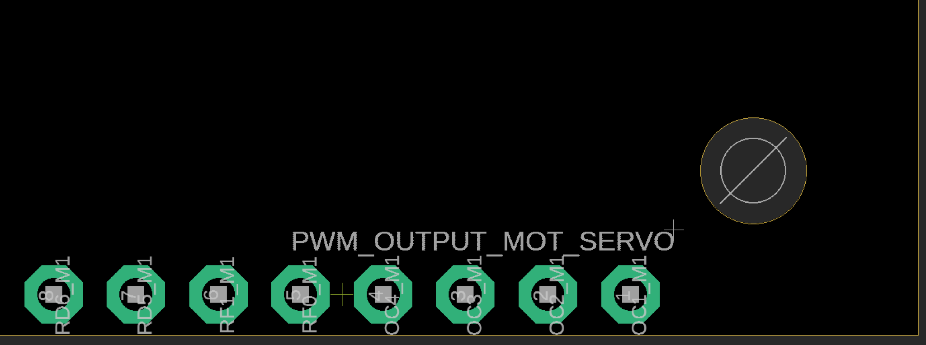
PCB Actuator Verification Method
System Requirement: Manufactuability
Expectation: Verify servo and motor PWM signal from PIC32 microcontroller
4x Servo PWM signal
4x motor PWM signal
Probe each of the through hole pins to measure PWM output signal from microcontroller
Located on PCB
Block diagram for actuator PWM debugging

Slide 6
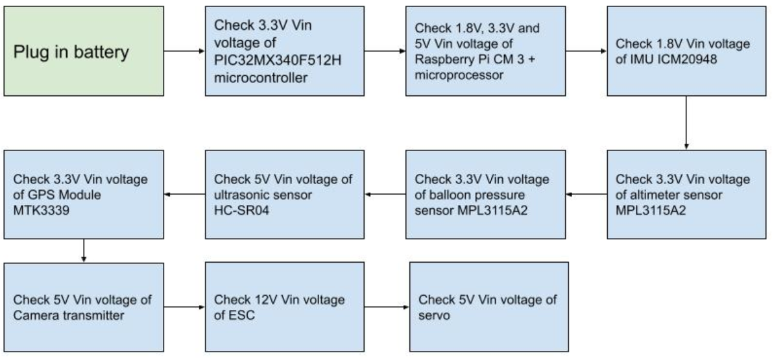
PCB Power System Verification Implementation
Expectation: All electronics powered by drone battery are expected have correct voltages at their respective Vin pins.
Block diagram for PCB Power System Verification

